Slide 1
Two Ways of writing a get service method
package com.nishant.microservice.startup;
@RestController
public class HellowWorldController {
@Autowired
UserService userservice;
@RequestMapping(method = RequestMethod.GET, path = "/GetUsingRequestMethod")
public String getHelloStringUsingRequestMethod() {
return "HelloUsingRequestMethod";
}
@GetMapping(path = "/GetUsingGetmapping")
public String getHelloStringUsingGetMapping() {
return "HelloUsingGetMapping";
}
}

Slide 2
RestController
@RestController is a specialized version of the controller. It handles http request
It includes the @Controller and @ResponseBody annotations, and as a result, simplifies the controller implementation:
Now what is a controller actually???????
We can annotate classic controllers with the @Controller annotation. This is simply a specialization of the @Component class, which allows us to auto-detect implementation classes through the classpath scanning.
We typically use @Controller in combination with a @RequestMapping annotation for request handling methods.
@RestController
@RequestMapping("books-rest")
public class SimpleBookRestController {
@GetMapping("/{id}", produces = "application/json")
public Book getBook(@PathVariable int id) {
return findBookById(id);
}
private Book findBookById(int id) {
// ...
}
}
RestController Annotation

Slide 3
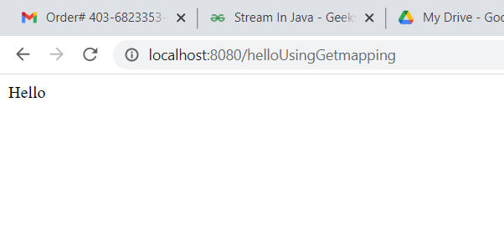
OUTPUT

